Slide 1
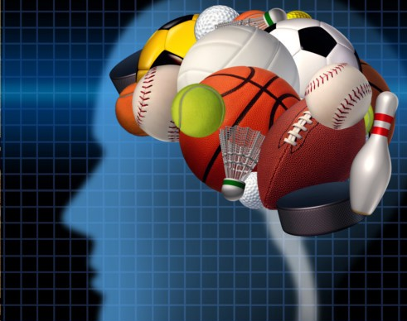
Sports & Mental Health
Our discussion points:
Prevalence of mental health issues
Physical health, academics & sports
Sports anxiety & Elite sportspersons
Mind of an elite athlete
Choosing the right sport
Some intriguing question
Manas K Mandal

Slide 2

Mental Health
‘A state of wellbeing in which every individual realizes his or her own potential, can cope with the normal stresses of life, can work productively and fruitfully and is able to contribute to her or his community’
It is a state of complete physical, mental and social wellbeing and not merely the absence of disease or infirmity.

Slide 3
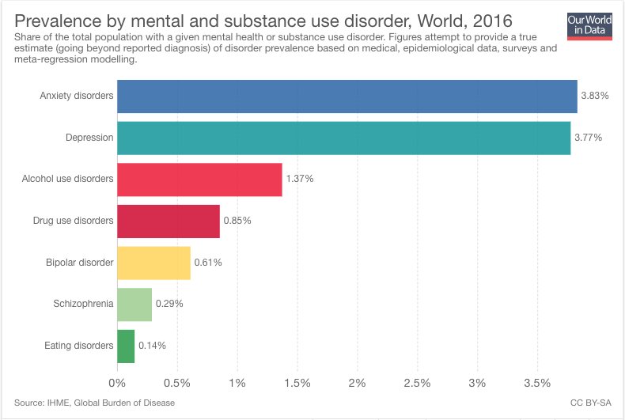
Mental Health Condition: Prevalence worldwide
Depression: 3.3 in 100 people
Generalized anxiety disorder: 5.9 in 100 people
Panic disorder: 0.6 in 100 people
Mixed anxiety & depression: 7.8 in 100 people

Slide 4
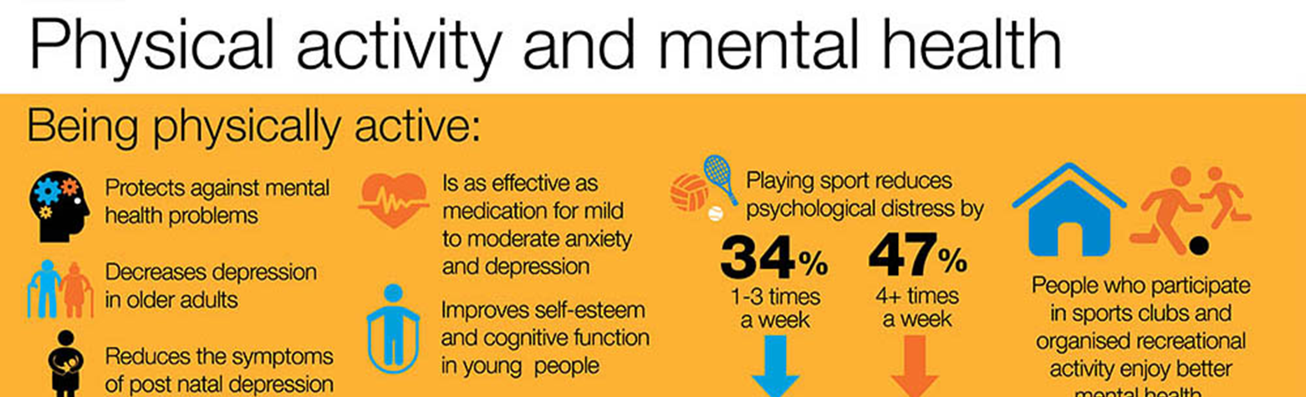
Mental health problems are common; account for the largest single source of disability
Evidence linking physical activity with enhanced mental health & wellbeing is well-known
The Royal College of Psychiatrists recognize exercise prescription as a treatment modality for a wide range of mental health conditions
Strong evidence exists showing a 20-30% reduction in depression in adults who participate in physical activity daily

Slide 5
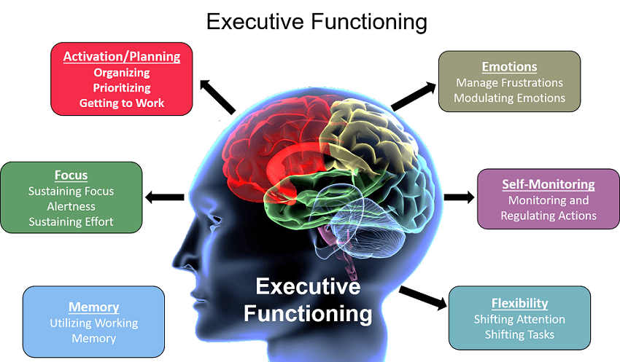
Did you know?
Research shows replacing academic lessons with physical activity does not have a detrimental impact on grades
In fact, increased participation in physical activity leads to better grades
Short amounts of exercise benefits executive functions.

Slide 6

Sports vs Academics
How does Rohan feel?
"My parents are great, but why do they always tell me what to do? It stresses me out."
"Why does mom keep a tab on every minute of mine? She is over-scheduling me though I know that she wants me to focus on studies too."
"It is like I'm never quite good enough; I can't fully please my parents, either in sports or studies.“
Rohan's mom has her own set of thoughts:
"By the time he is home, he will again be too tired to finish his homework."
"What if he doesn't turn out to be a good sports person and lags behind in studies too?"
"I hope he understands one day, that I am doing this for his own good!"
https://www.indiatoday.in/education-today/featurephilia/story/balancing-sports-and-academics-330125-2016-07-19

Slide 7
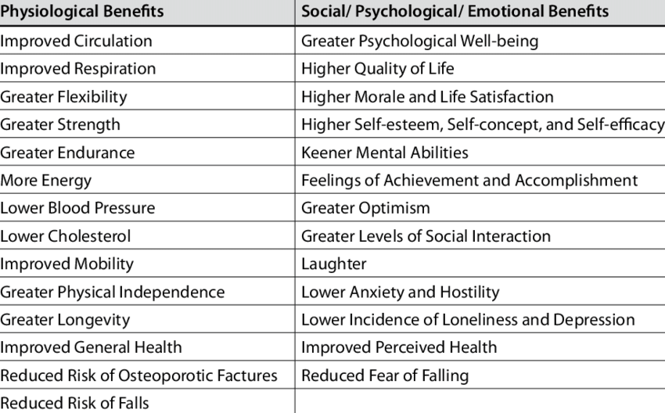
Benefits of sports activities

Slide 8
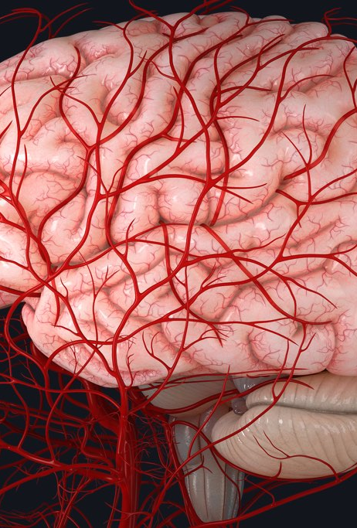
Why is this: Biological factors?
Exercise increases blood flow to the cortex of the brain; attribute to brain growth factor
Regular physical activity may reduce plasma noradrenaline (a vasoconstrictor which reduces blood flow to the brain)
Exercise positively impacts levels of serotonin, a chemical that stimulates the neurotransmitter norepinephrine, which improves mood
Physical activity releases endorphins, the body’s natural “happy chemicals,” and reduces levels of the stress hormone cortisol.

Slide 9
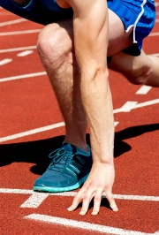
Why is this: Psychological factors?
Sports are associated with lower rates of stress, anxiety, depression, and suicidal behavior
Participation in team sports reduces the risk of substance abuse and other reckless behaviors
Team sports enhance resilience, empathy, confidence and empowerment
Increase executive functioning, creativity, cognitive development, and self-regulation
Sleep improves which is essential for mental health

Slide 10
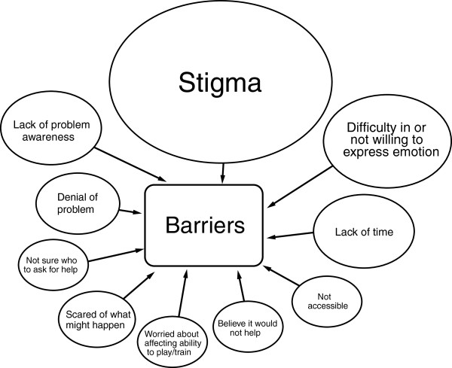
Mental health in sports
Mental health problems that may be more common in those who play sport professionally, not recreationally
Certain subgroups among professional sport show increased prevalence of mental ill health:
retired elite athletes;
those experiencing performance failure;
those who have suffered injury and other major negative life events (which happen to athletes more often as young adults

Slide 11
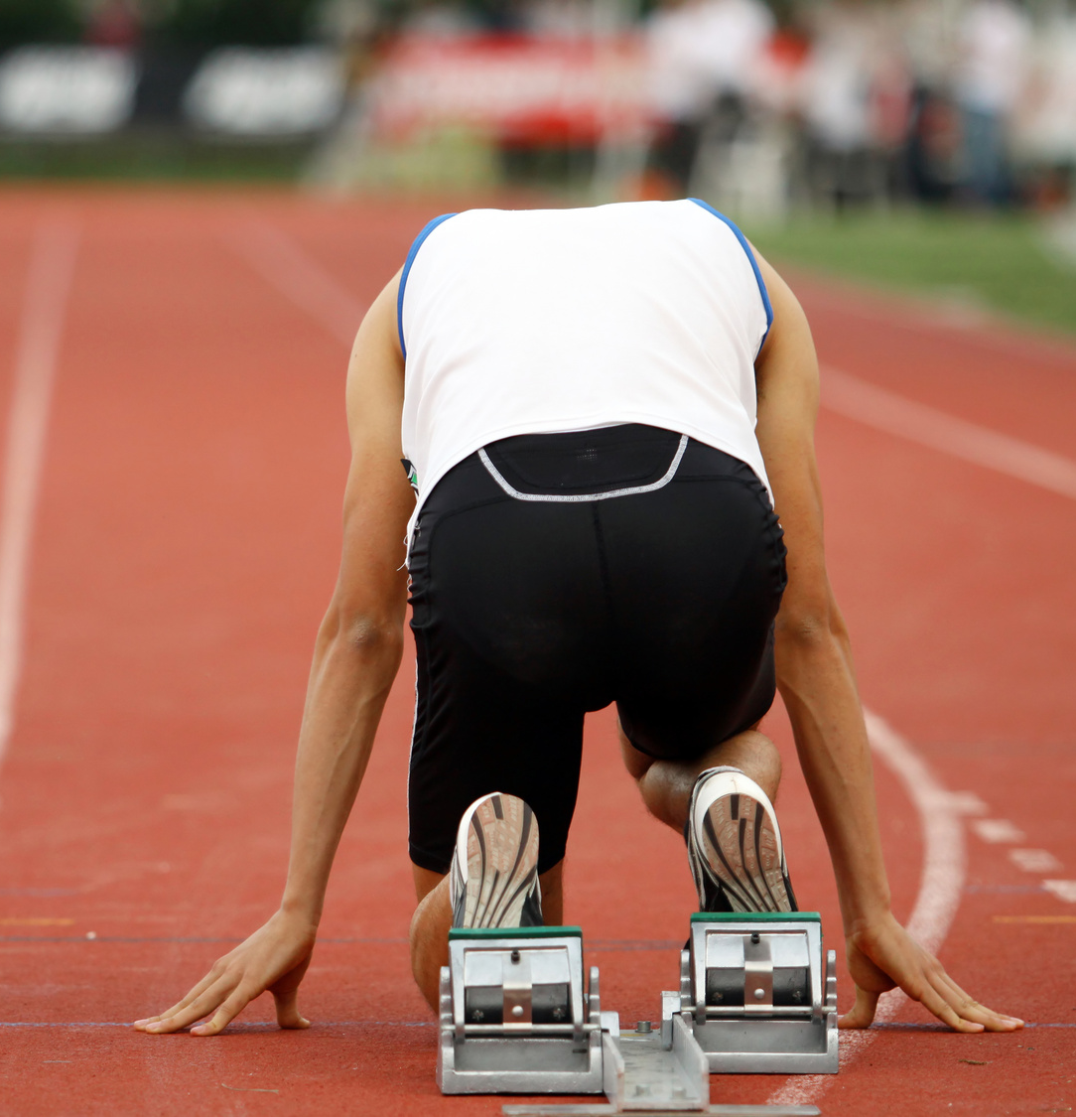
Sports anxiety
The tense state that anxiety puts the body in makes it more difficult to execute the coordinated movements athletic events require
Besides causing physical setbacks, anxiety also brings negative thought patterns and expectations of failure that can easily turn into self-fulfilling prophecies
Factors affecting sports anxiety:
Unpredictability of outcome
Spectators in the gallery
Sense of Isolation in individual games
Possibility of getting hurt in high contact sports
Expectation of success
Level of competition

Slide 12
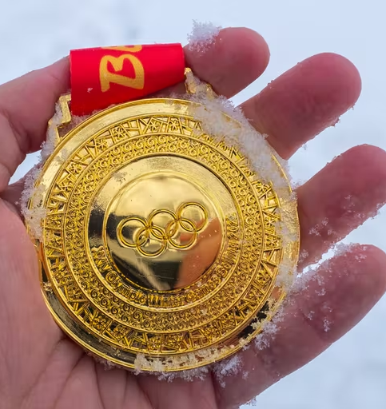
Post Olympic depression syndrome
Around 24% of Olympic and Paralympic athletes reported experiencing high or very high psychological distress after the Games
Factors include:
Failing to live up to performance expectations, not making a final or not achieving a personal best
Euphoria of winning wanes
Loss of celebrity status
Trouble readjusting at home
Less social support from teammates
Injury
Lack of routine after competition

Slide 13
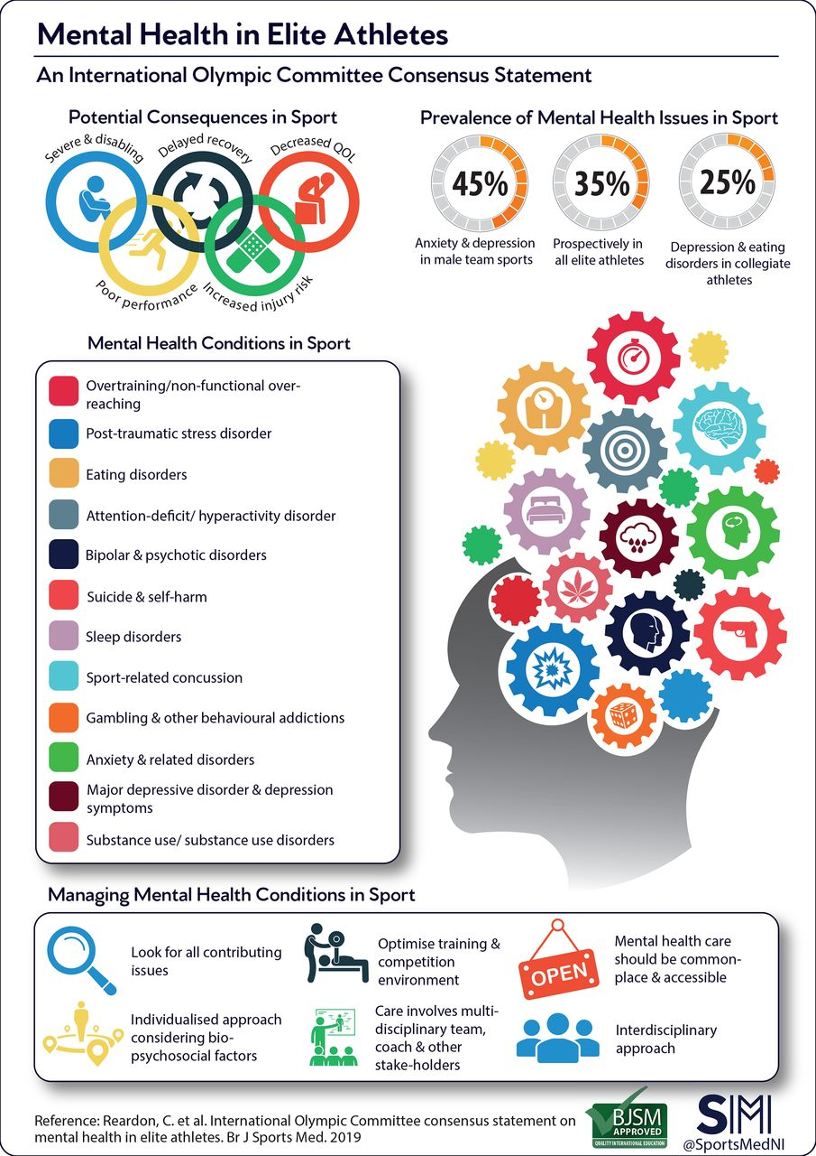
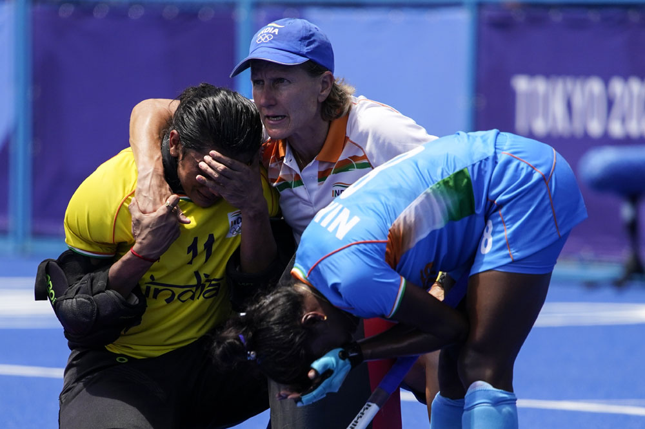
Mental health issues in elite athletes
https://bjsm.bmj.com/content/54/1/49

Slide 14
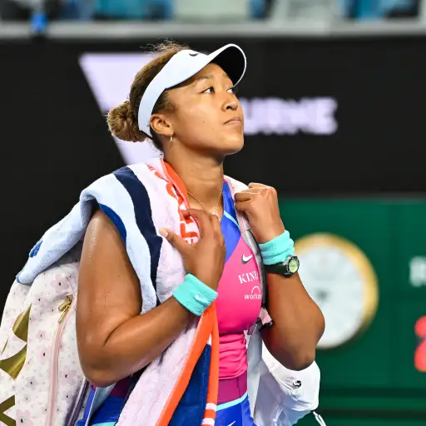
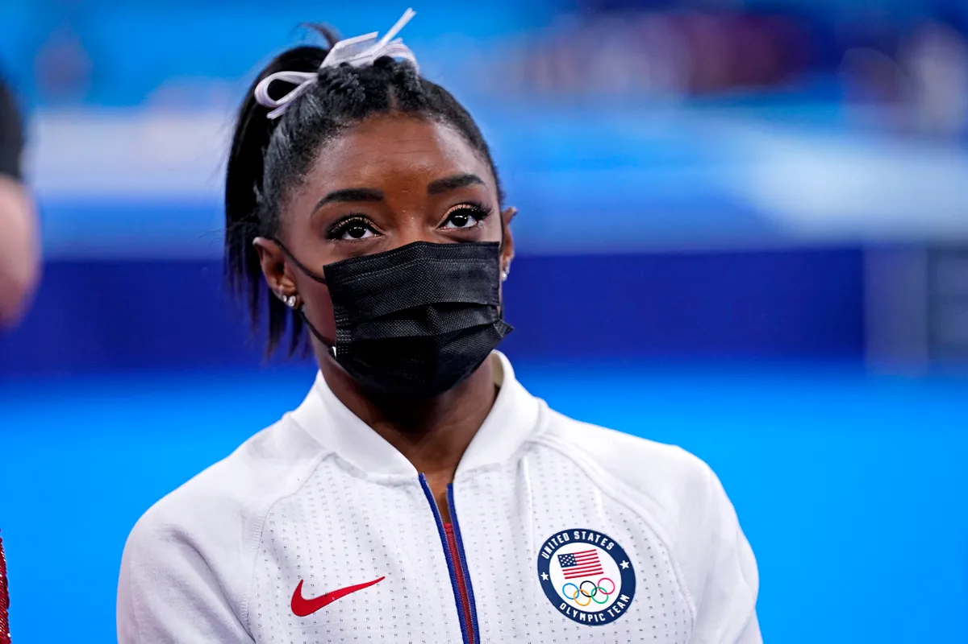
Mental health issues in elite athletes
Tennis star Naomi Osaka who dropped out of the French Open due to issues related to depression and social anxiety,
Gymnast Simone Biles, who withdrew from the team finals at the Summer Games citing mental health issues

Slide 15
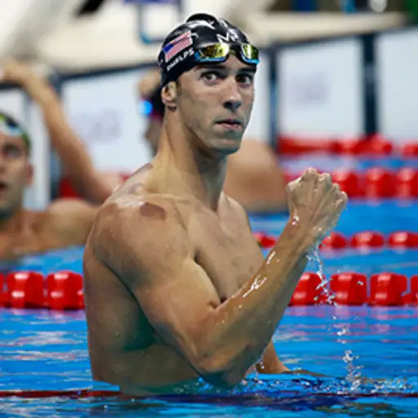
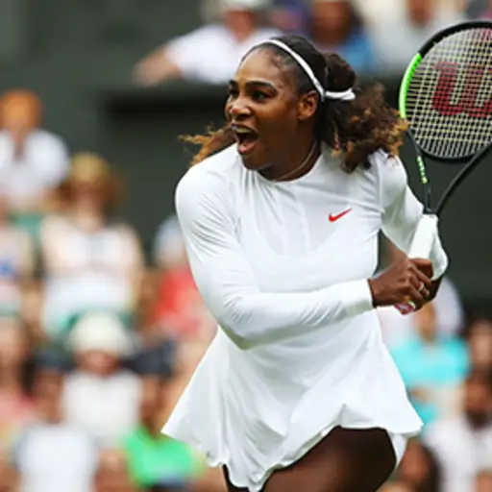
Mental health challenges in elite athletes
Swimmer Michael Phelps is the most successful and most decorated Olympian of all time, boasting a total of 28 medals, but that didn’t make him immune to depression. “After every Olympics I think I fell into a major state of depression,” said Phelps in a 2018 interview with CNN
In 2011, Serena Williams revealed that she had been battling depression since winning Wimbledon the previous year, following injuries and health difficulties. “I cried all the time. I was miserable to be around,” she said in a 2011 interview with The Telegraph

Slide 16
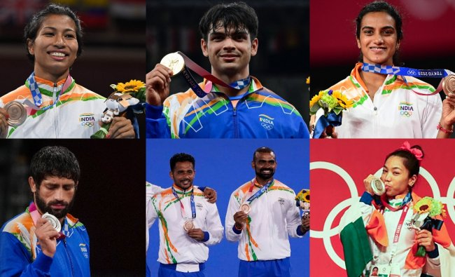
Mind of a Medalist
The ability to cope with & control anxiety
Confidence, Mental toughness/resiliency
Sport intelligence, performance innovation
The ability to focus & block out distractions
Competitiveness & a hard-work ethic
The ability to set and achieve goals
High levels of dispositional hope
Optimism & adaptive perfectionism

Slide 17
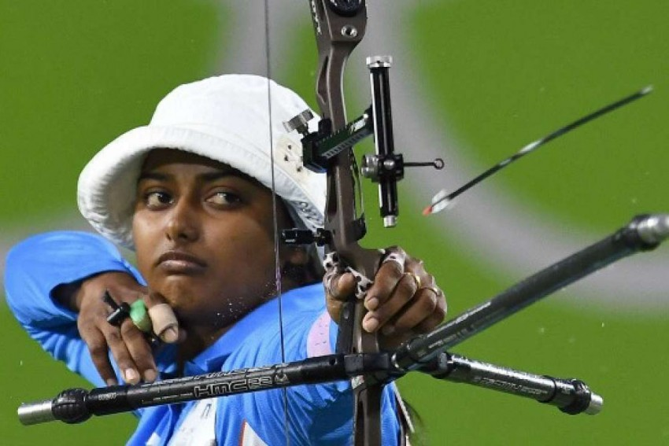
Mind of a Medalist
Factors beyond practice: Attentional control, working memory, lower level of neuroticism
Motivational self-talk (I can do it): Increase confidence, regulate emotional reactions, trigger psychomotor reactions
Instructional self-talk (keep your eyes on the target): Eye-hand coordination, precision, accuracy
Multi-disciplinary practice: Early multidisciplinary practice, not early specialization, predicts world-class performance (Gullich et al., 2021)

Slide 18
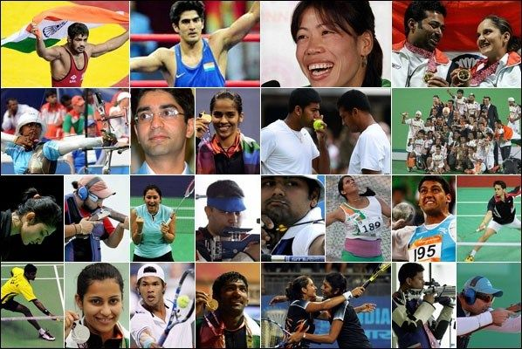
Some questions…
Do you play any sports these days? If not, how do you get exercise?
Which sports do you enjoy watching on TV? How much time do you spend watching them?
What sports did you play as a child? What was your proudest moment?
Is sport an important part of education? What does it teach people?
Who is your all-time favorite sportsperson?

Slide 19
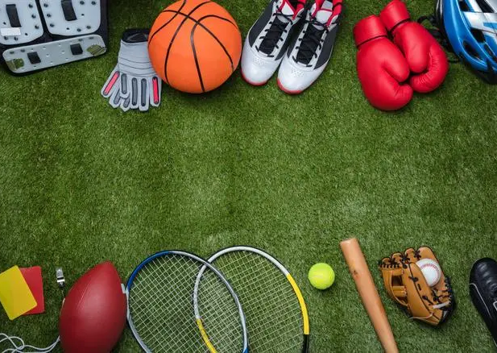
Choosing the right sport
So many sports, only one you…
Recreational (playing football in summer & badminton in winter) or professional (developing a paired career)
Doing sports alone or as a team…
What options are available in your location…
Organized sport (football, cricket, tennis) or all-round physical activity (climbing the rock, hiking, biking, swimming, jogging)
Take an off-season (not a season off)…

Slide 20

Choosing the right sport…
Try an assortment of sports first
Consider your physical attributes
Decide the type of exercise you want to focus on
Consider your personality, needs, interests
Understand your temperament, motivation
Set some goals for yourself before you start
Check your lifestyle

Slide 21
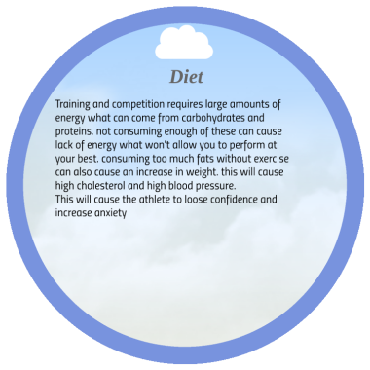
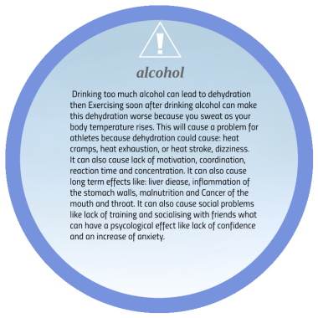
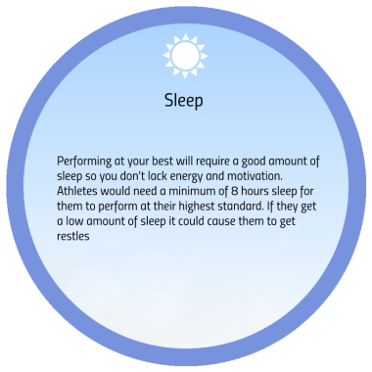
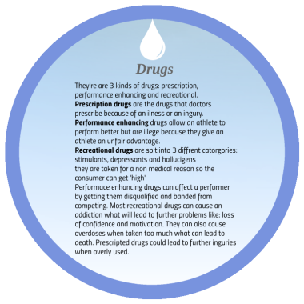
Lifestyle factors that affect sports performance

Slide 22
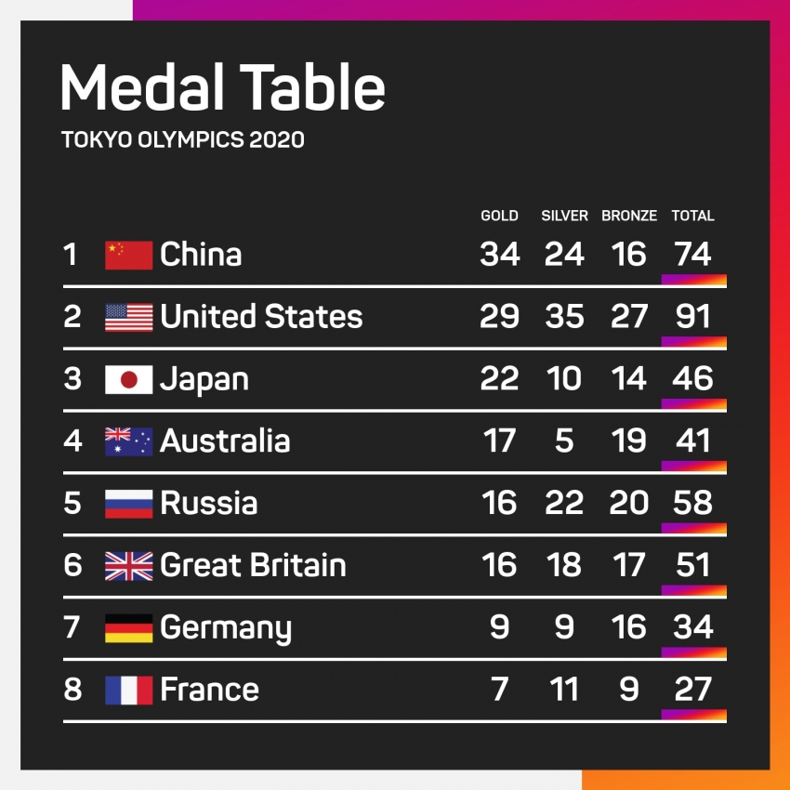
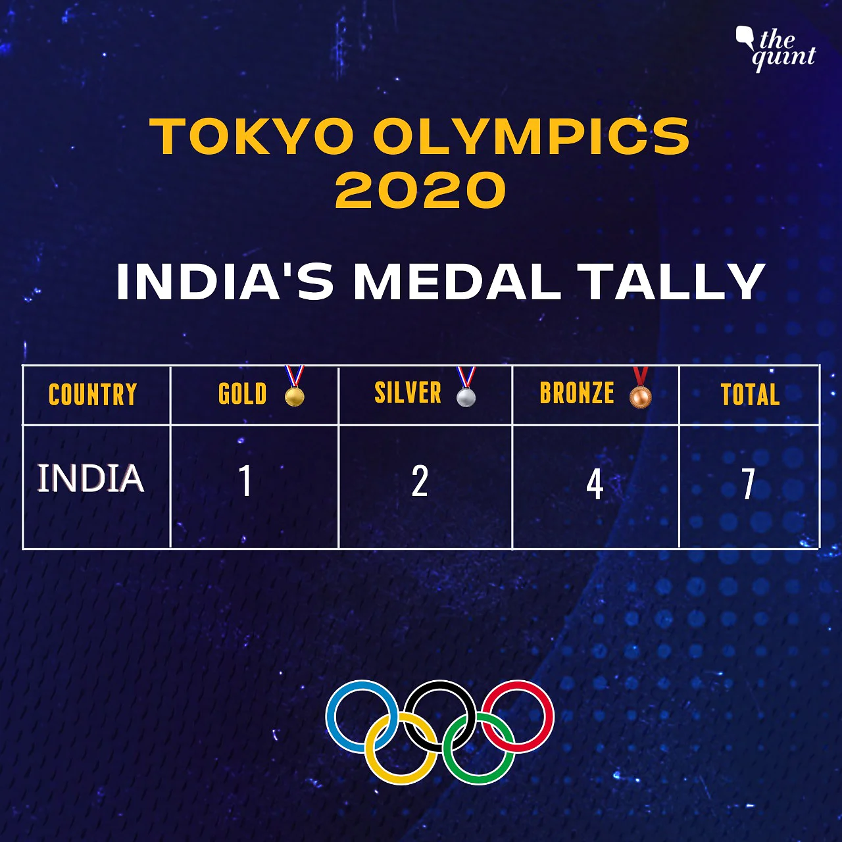
Debate
Which is the sportiest country in the world?
Our country is best at which sports? Why is it strong at these?
People compete in sports, games, the economy and many other areas of life. What is good and bad about competition?
Is motor-racing really a sport? How much recognition should we give to the engineers and designers versus the drivers?
What is different between sports and e-sports?
Should e-sports be included in the Olympics?
Is there too much money in sport? Are athletes paid too much or too little?

